Slide 1
Chernobyl disaster

Slide 2
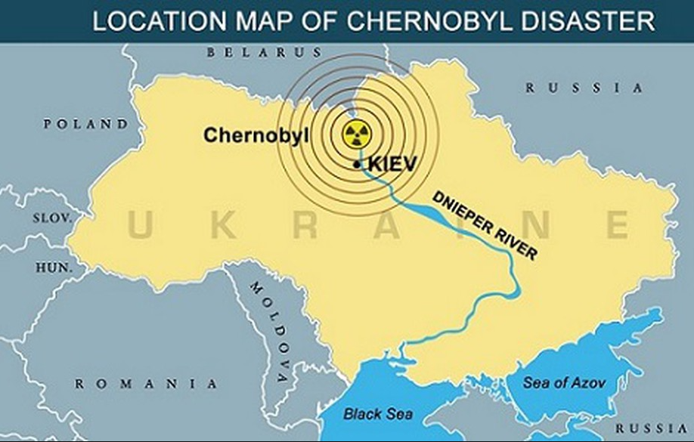
Where is Chernobyl and the power plant ?
In Northern Ukraine.
10 miles away from Belarus.
80 miles from North of Kiev.
The Power Plant is located 11 miles north of the city of Chernobyl.
Plant consisted of 10% of Ukraine’s electricity.
Construction began in the 1970s.
Reactor #4 was completed in 1983.
At the time of accident, reactors #5 and #6 were in progress.

Slide 3
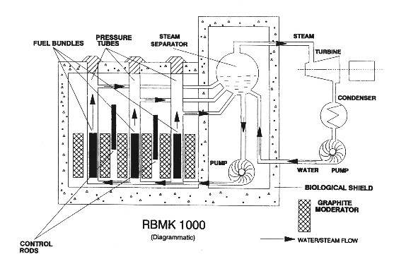
Schematic of the reactor

Slide 4
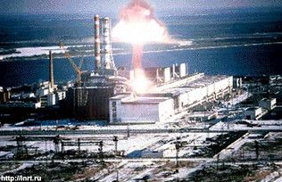
What happened on 26th April, 1986?
Test to the backup cooling system in reactor #4.
Power fell too low, allowing the concentration of xenon-135 to rise.
The control rods were pulled out and the coolant pumps were shut down.
Power level went up and all the control rods were inserted but they become deformed and stuck.
The rods melted and the steam pressure caused an explosion at 1:23 am.
This dispersed large amount of radioactive particulate ana gaseous debris into the atmosphere.

Slide 5
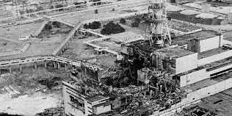
REASONS behind the Accident
Lack of knowledge, experience and training for the workers.
Insufficient communication.
Poor safety systems and quality.
After the explosion,
It releases tons and tons of radioactive gases into the atmosphere.
Fire lasted for 15 days.
7 million lived in contaminated areas; 3 million were children.
Wind carries radiation far distances.
The toxicity was equivalent to 400 Hiroshima atomic bomb explosions.

Slide 6
Victims into groups
The Chernobyl Catastrophe victims comprised four main groups.
Liquidators
Evacuees
Relocation zone/ residents
Offspring

Slide 7
LONG TERM IMPACTS
International spread of radioactivity.
Radioactive release.
Residual radioactivity in the environment.
Health effects.
Socio economical impact.

Slide 8
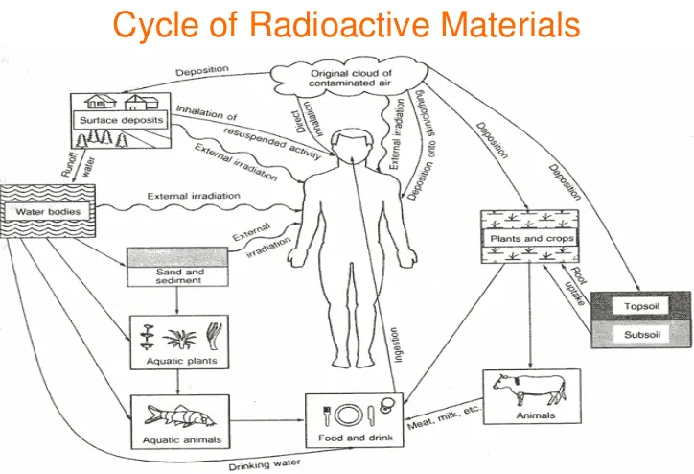

Slide 9
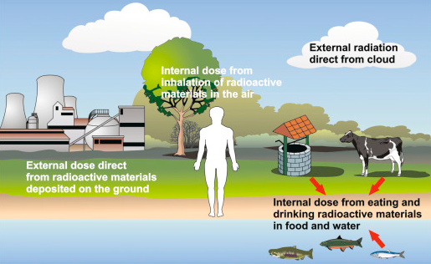
What has been done to reduce exposure?
Decontamination of settlements in contaminated regions.
Exclusion of contaminated pasture grasses from animal diets.
Rejection of milk based on radiation monitoring data.
Feeding animals with “clean” fodder.

Slide 10
THANK YOU!

